Slide 1


Continuous Delivery/Deployment
The final stage
Presenter
Mohammad Anees Alam
Notes:
1

Slide 2





Topics for today!
Recap: Continuous deployment
Deployment Vs Delivery
Common CD tools
Deployment Pipelines
Hands-on activity: Setup CD for flask app
Notes:
2

Slide 3
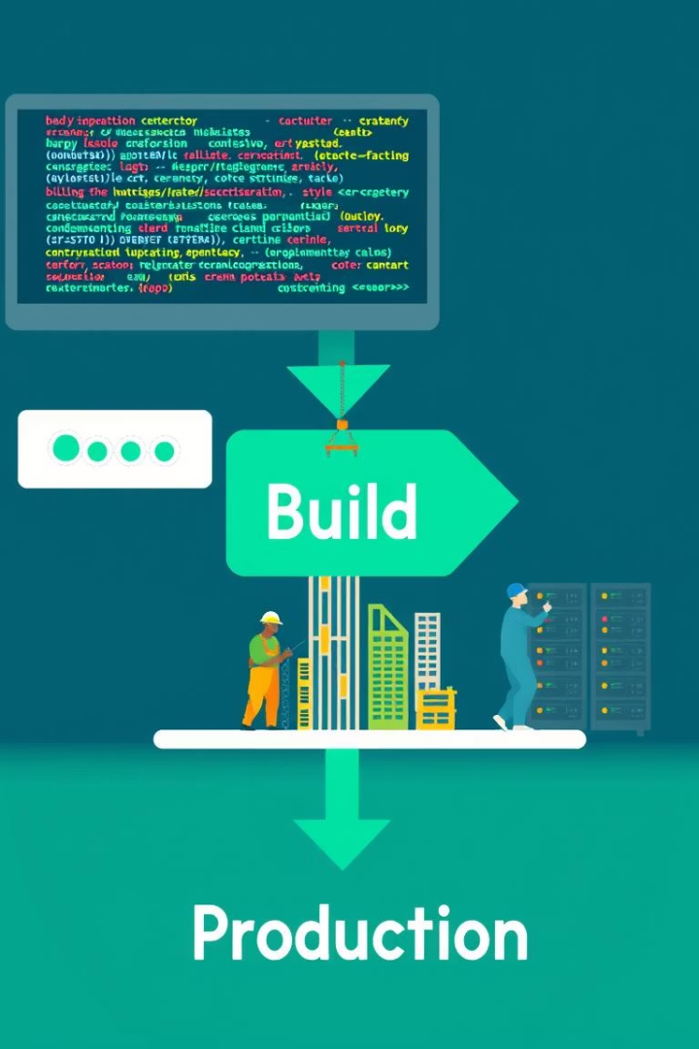




Why Continuous Deployment Matters
Continuous Deployment is a DevOps practice in which every code change that successfully passes all stages of the production pipeline is automatically released to users, without any manual steps.
It represents the final phase of the CI/CD pipeline.
Faster Time-to-Market
Enables rapid feature delivery to users.
Automation-Driven
Reduces human errors and delays in deployment.
Improved Stability
Code is thoroughly tested before reaching users.
Faster Feedback
Bugs are identified and resolved quickly.
Notes:
3

Slide 4

Real-World CD Success Stories
1000s
11.7s
24/7
Netflix
Amazon
Facebook
Daily deployments using Spinnaker
Average time between deployments
Continuous incremental changes
Notes:
4

Slide 5



CI vs. CDel vs. CDep
Continuous Integration (CI)
Automates testing and code merging only.
Continuous Delivery (CDel)
Automates testing and packaging. Requires manual deployment approval.
Continuous Deployment (CDep)
Fully automated process including production deployment.
Notes:
5

Slide 6
Comparing Delivery vs. Deployment
Feature
Continuous Delivery
Continuous Deployment
Production Deployment
Manual Trigger
Fully Automated
Risk
Moderate
Low (with robust automation)
Feedback Speed
Slower
Instant
Best For
Regulated Industries
SaaS, startups, agile teams
Notes:
6

Slide 7
Hands-on Activity
Let's analyze the code differences between continuous delivery and continuos deployment.
1
Clone this Repository
GitHub - Anees-DevOps/CI-CDel-CDep
Analyze the sample GitHub Actions YAML files.
2
You will find different folders for each type within the repository
Identify whether each pipeline represents CI, CDel, or CDep.
3
Understand the flow of steps
Notes:
7

Slide 8
CD Tools Overview
Jenkins
GitLab CI/CD
Open-source automation server best for custom enterprise solutions.
Built into GitLab, offering seamless Git integration.
GitHub Actions
Spinnaker
GitHub-native automation ideal for open-source/student projects.
Multi-cloud deployment tool for advanced CD in large organizations.
Notes:
8

Slide 9





Deployment Pipeline Stages
Code Commit
Developer pushes code to repository.
Build
Code is compiled and packaged.
Testing
Unit and integration tests run.
Staging
Deploy to staging environment.
Production
Final deployment to users.
What are the tools used in each of these stages..?
Notes:
9

Slide 10
Practical Exposure
Let’s practically understand and observe how continuous deployment works by deploying a website onto GitHub pages.
1
Clone this Repository
https://github.com/Anees-DevOps/CD-Demo_test.git
Analyze the GitHub Actions YAML files.
2
You will find different files for each type within the repository
Understand the entire workflow and execute it
3
Understand the flow of steps
Notes:
7

Slide 11




Assignment: Setup CD for Flask App
Setup Flask App locally
Create a simple Flask application with basic tests -or- clone from here - https://github.com/Anees-DevOps/Setup-CD.
Configure continuous delivery in deploy.yml
Create workflow file for CI/CD pipeline.
Enable Manual Approval
  Go to your repo → Settings → Environments → New environment: production
  In production, enable:
    Required reviewers
    Add yourself or fellow mates for approval
Upgrade to Continuous Deployment
Remove manual approval for fully automated deployment.
Notes:
10

